Slide 1
Team 24 COVID Gaming App
Kate Donovan, PhD, MBA, MS
Renee Evans, MS
Blaze F. Hirsch MSN, CMS-RN, CNML
Josef Sierra-Birn (devoted gamer)

Slide 2
Problem Statement
Pediatric cases linked to COVID-19 are on a rise (Dean, 2020).
Employers are looking to reopen, but schools and child care facilities are not. Children need education that reaches them where they are.
Misconception that those under a certain age demographic will not contract, present related symptoms, or spread COVID 19 (Dean, 2020).

Slide 3
Challenge & Idea
How might we protect children from the spread of COVID-19?
Create a gaming app to educate users ages 6 to 14 about COVID-19 and how to combat the virus.
Partner with current franchises like Minecraft, FortNite, or another game to roll out and educate our audience

Slide 4

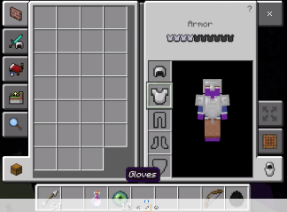
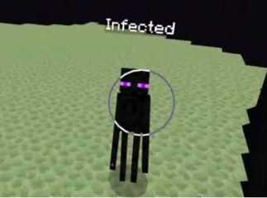

Gaming Concept (Minecraft)
Develop (or leverage) a gaming platform (e.g. Minecraft) that allows end users to learn more about COVID 19, how they can protect themselves their friends, and their family, while having fun!
Josef Sierra-Birn, 12 y/o devoted video game player, agrees that using a platform like Minecraft will be a great way for kids to learn how to 'fight' COVID-19 through preparedness, social distancing, and by simply having fun and defeating the "COVID Dragon".
Players equip themselves with the proper PPE and tools to fight the COVID Dragon!
Be sure to remain 6-ft away from "The Infected" (or "The Corona")
Keep 6-Ft Distance
Goal is to defeat the COVID Dragon and win a "Vaccine Potion" to save the village (or world)

Slide 5

Why This Solution?
Education in a fun and engaging way will help develop best practice behaviors.
Reaching the youth population will likely promote engagement among other age demographics as well.
Components of the game can be leveraged to further educate youth internal or external from the app (e.g. tips, Did You Know features)
Offer parents a platform to help educate their children about COVID-19 in a easy and fun way that is translatable.
Reduces the risk of spreading the virus within the pediatric / youth population potentially decreasing the influx of pediatric COVID 19 -related emergencies.

Slide 6
Team Members
Kate Donovan, PhD, MBA, MS kdhaha@gmail.com
Renee Evans, MS, renee.evans.lynn@gmail.com
Blaze F. Hirsch MSN, CMS-RN, CNML blazehirsch@gmail.com
Josef Sierra-Birn (devoted gamer)

Slide 7
References
Dean, Kelly (13 May 2020). "Pediatric cases of COVID-19 rise in Warren County, doctor says severe cases are rare." ABC News. Retrieved from https://www.wbko.com/content/news/Pediatric-cases-of-COVID-19-rise-in-Warren-County-doctor-says-severe-cases-rare-570449281.html

